Slide 1
REMOTE CONTROL ELECTROMECHANICAL LOCK FOR SINGLE DOOR COMMERCIAL REFRIGERATORS
promix-center.com

Slide 2
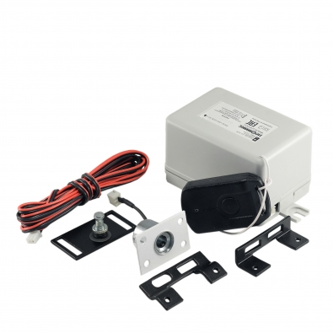
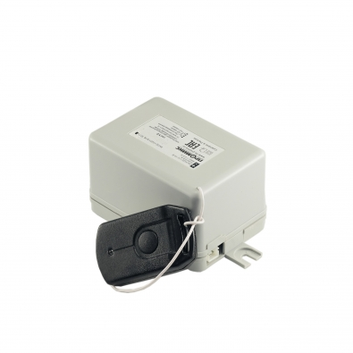
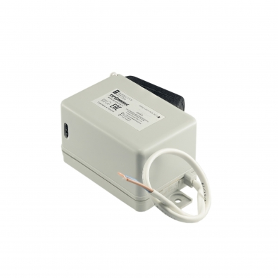
Promix-FRS.1D.01
Universal electromechanical lock for single-door refrigerator (set)
promix-center.com

Slide 3
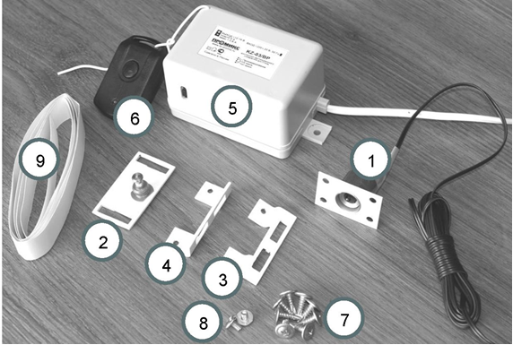
SCOPE OF DELIVERY
1 – Promix-SM.131.10 lock 1 pc.
2 – Promix -AD.DB.13 deadbolt 1 pc.
3 – Promix -AD.BR.05 bracket 1 pc.
4 – Promix -AD.BR.06 bracket 1 pc.
5 – Promix -CR.RX.02 controller 1 pc.
6 – Promix-CR.TX.01 RCU 1 pc.
7 – 4х16 self-tapping screws
(with pressing disk) 8 pcs
8 – М4х6 screw (with pressing disk) 2 pcs
9 – Self-adhesive vinyl film (25 mm)
for disguise camouflage of wire. 1 m
10 – Operating manual 1 pc.
promix-center.com

Slide 4
Remote control system via radio channel
Built-in power supply with electronic short circuit and overload protection
Programming directly from the controller (jumpers) and remotely using a master key fob
Up to 10 keyfobs can be recorded in the controller's memory
Possibility of separate replacement of the power supply and radio module during repair
promix-center.com

Slide 5
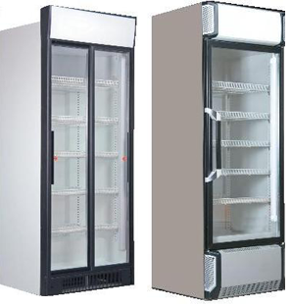
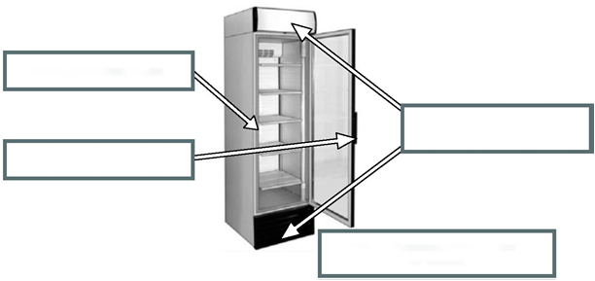
Installing the lock on single-door refrigerators. Installation and connection.
Designed for installation on the most of single-door commercial refrigerators of different producers.
Lock installation place
Installation places for the controller
Deadbolt installed
RECOMMENDED PLACES FOR INSTALLATIONS
promix-center.com

Slide 6
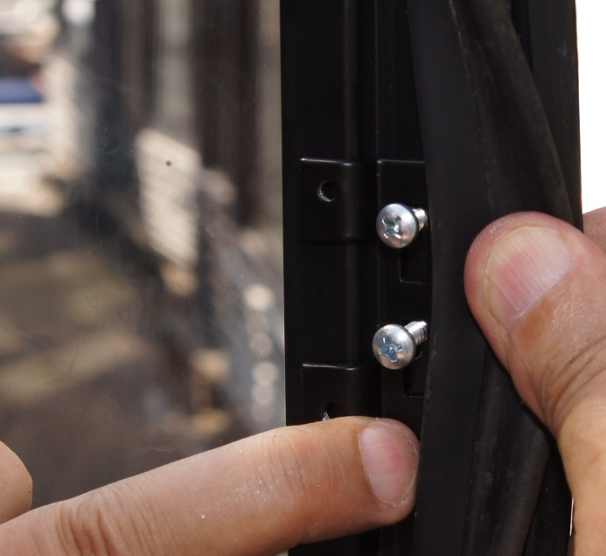
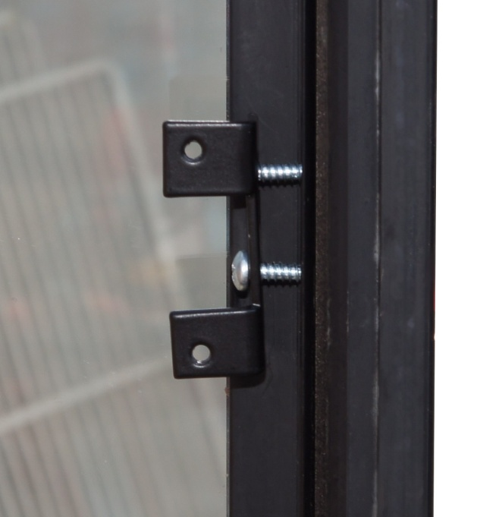
Depending on the type of door profile. To install
Promix -AD.BR.05 bracket
Promix -AD.BR.06 bracket
promix-center.com

Slide 7
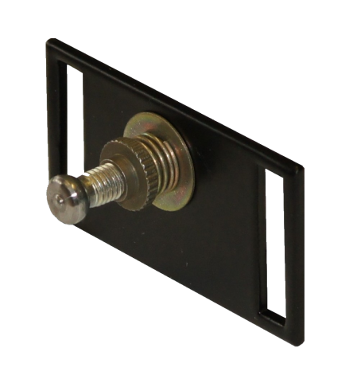
Deadbolt installation
Install the Promix-AD.DB.13 deadbolt
on the installed bracket
promix-center.com

Slide 8
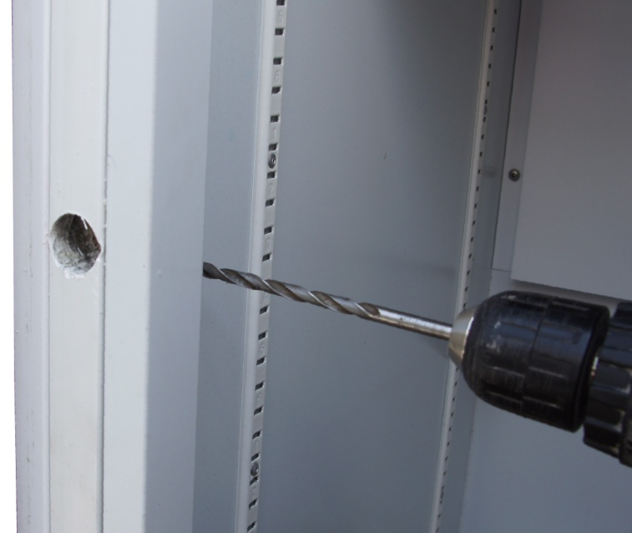
Lock installation
Close the fridge door and press on it – the bolt will make a mark on the walls of the door; Drill a hole with a diameter of 24 mm in the center of the mark; Drill a hole with a diameter of 6 mm from inside the refrigerator;
promix-center.com

Slide 9
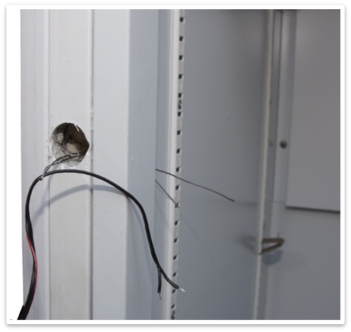
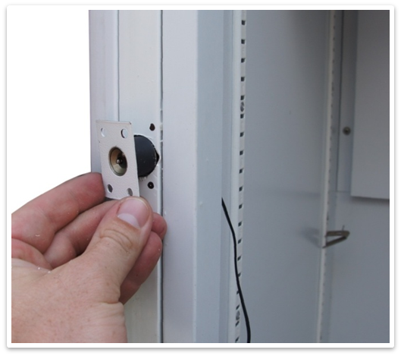
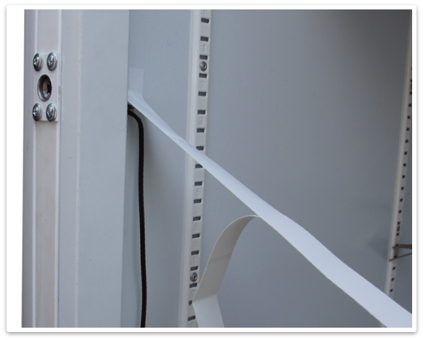
Lock installation
Stretch the lock wire with a wire loop;
Secure the lock, lay the wire and seal it with decorative tape;
promix-center.com

Slide 10
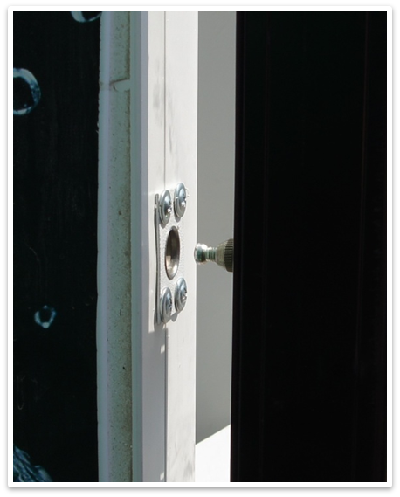
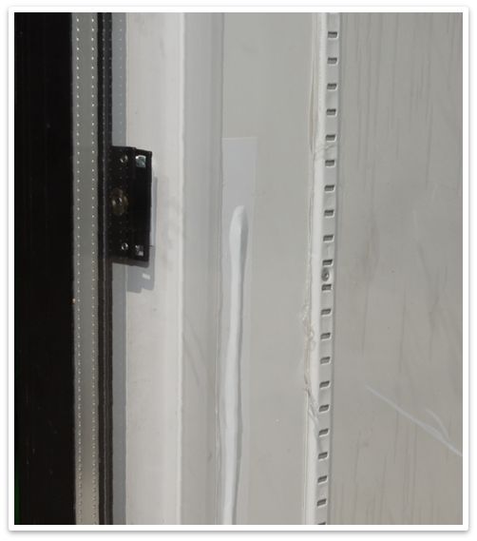
Testing
Check that the deadbolt easily enters the lock hole;
promix-center.com

Slide 11
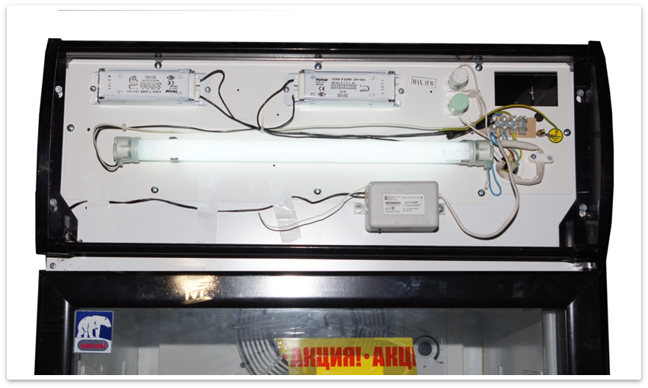
Controller installation
Install the controller behind the advertising panel or in the compressor compartment and connect to the 220V and to the lock;
promix-center.com

Slide 12
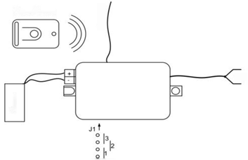
Controller connection diagram
Key fob/RCU
Antenna
220V
1 – setting of the Normally Open lock;
2 –setting of the Normally Closed lock;
3 –programming.
Lock
Controller
Jumper positions
promix-center.com

Slide 13
+7 (4812) 619-330
+7 (920) 317-18-47
mail@promix-center.com
dis@promix-center.com
Trusted by thousands of users!
promix-center.com

